Slide 1




data_wrangling() &&
("manipulation" %in% R)
🐨🐟🌿 %>% %>% %>% 🤓📊🥰
postgraduate_workshop(
dept = "Biological Sciences",
presenter = c(
"Ruan van Mazijk",
"MSc candidate"
)
)
> face()
> logos()

Slide 2
> introduce( )

Slide 3
> introduce( )
BSc + Hons here at UCT

Slide 4
> introduce( )
BSc + Hons here at UCT
Ecology & evolution
(Mostly plant) comparative biology
Biogeography

Slide 5
> introduce( )
BSc + Hons here at UCT
Ecology & evolution
(Mostly plant) comparative biology
Biogeography
Been working with R for 4½ years
Every major project I’ve done…

Slide 6
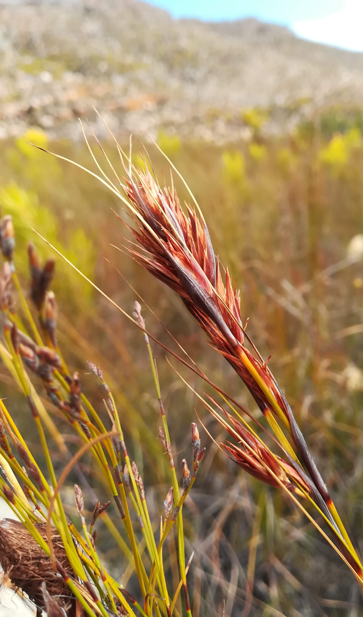
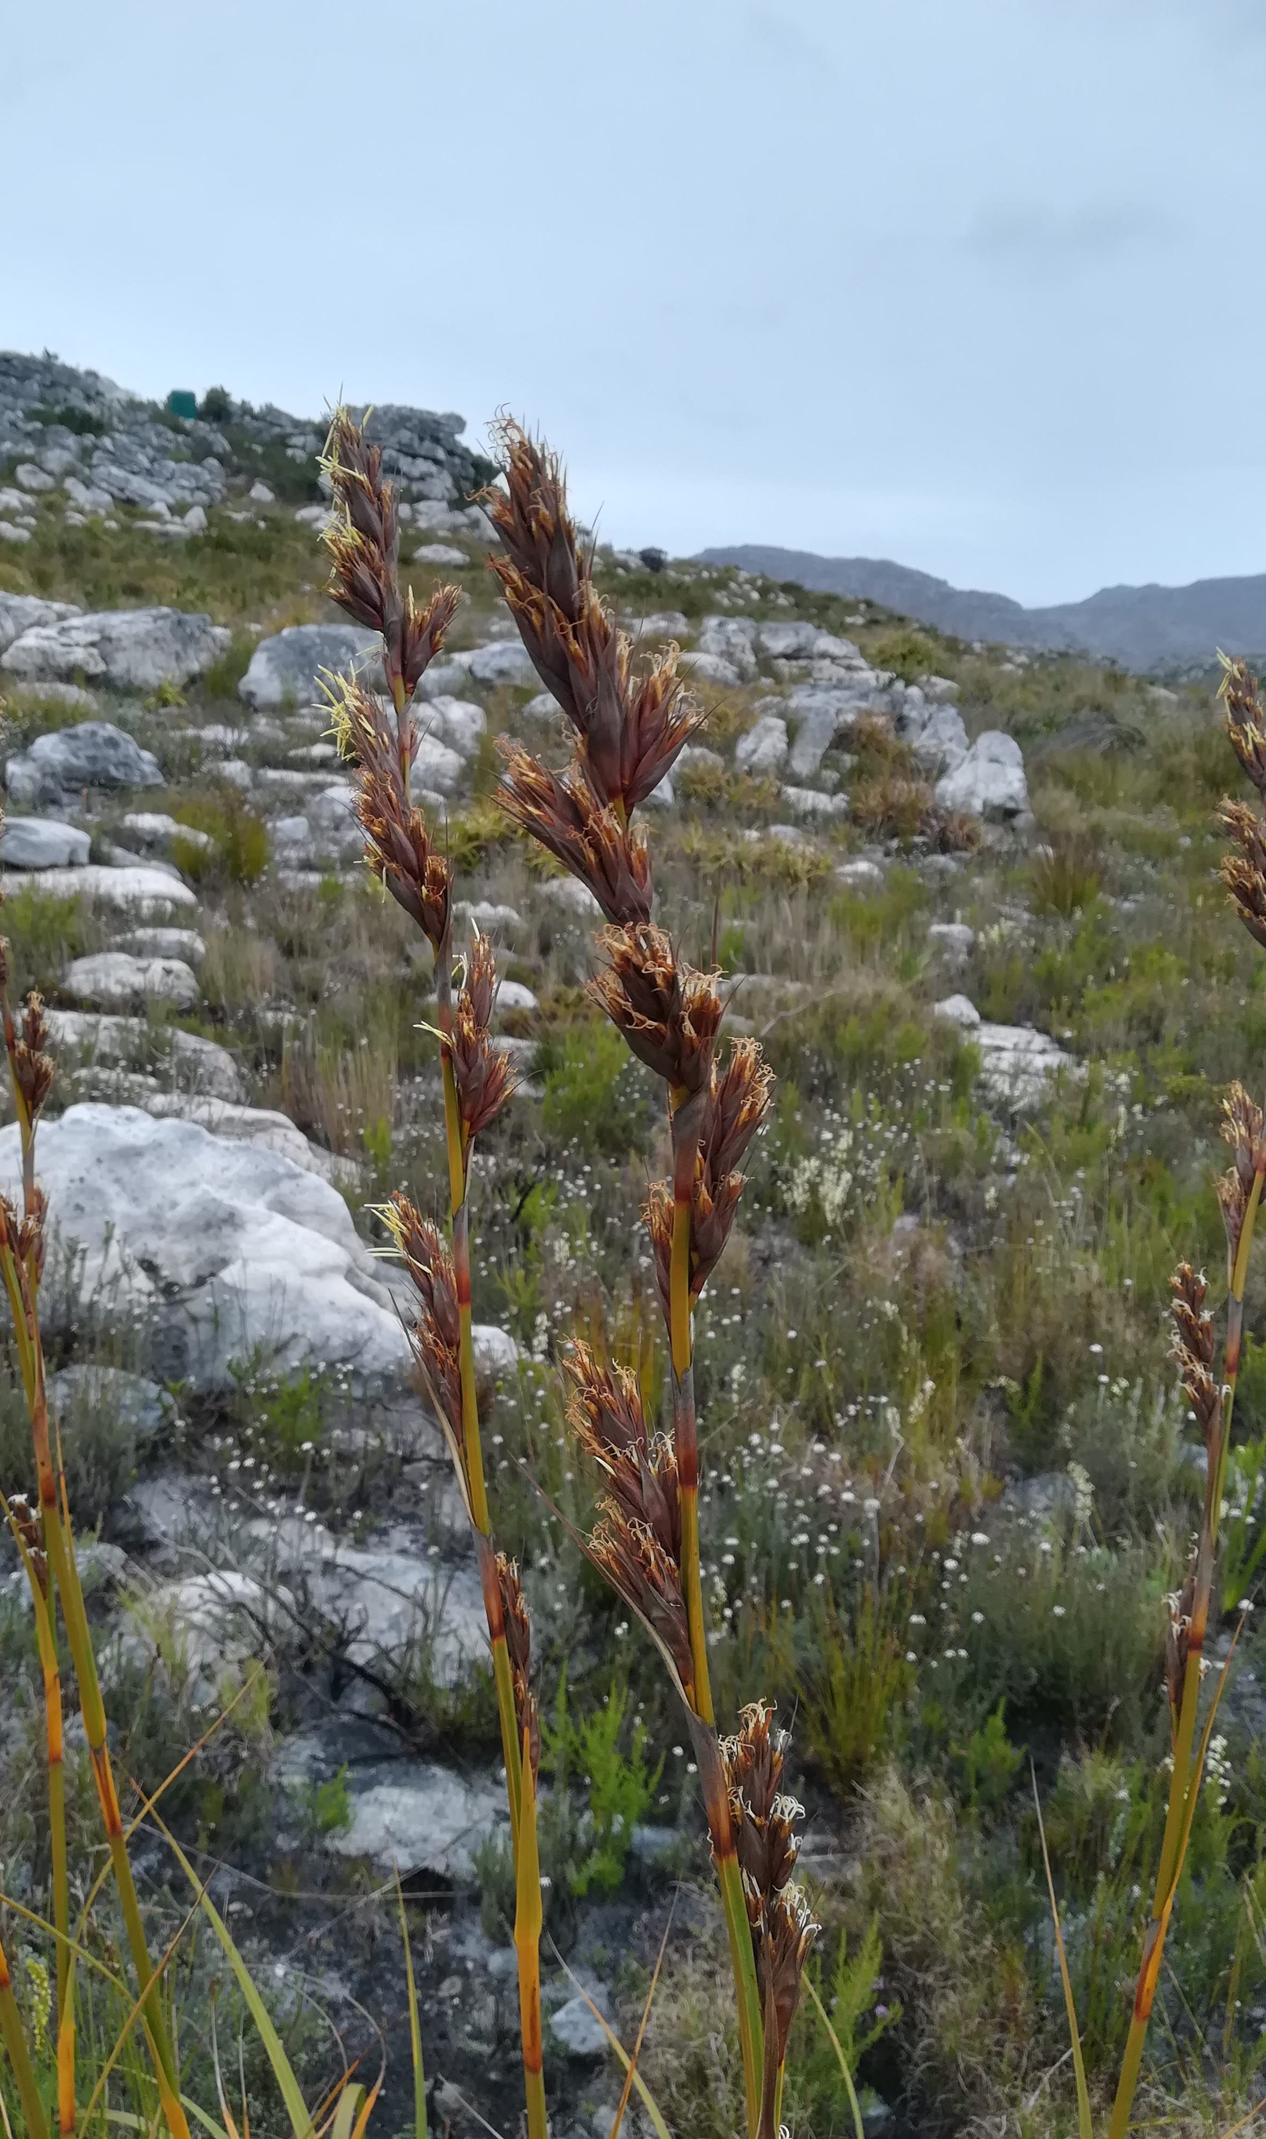
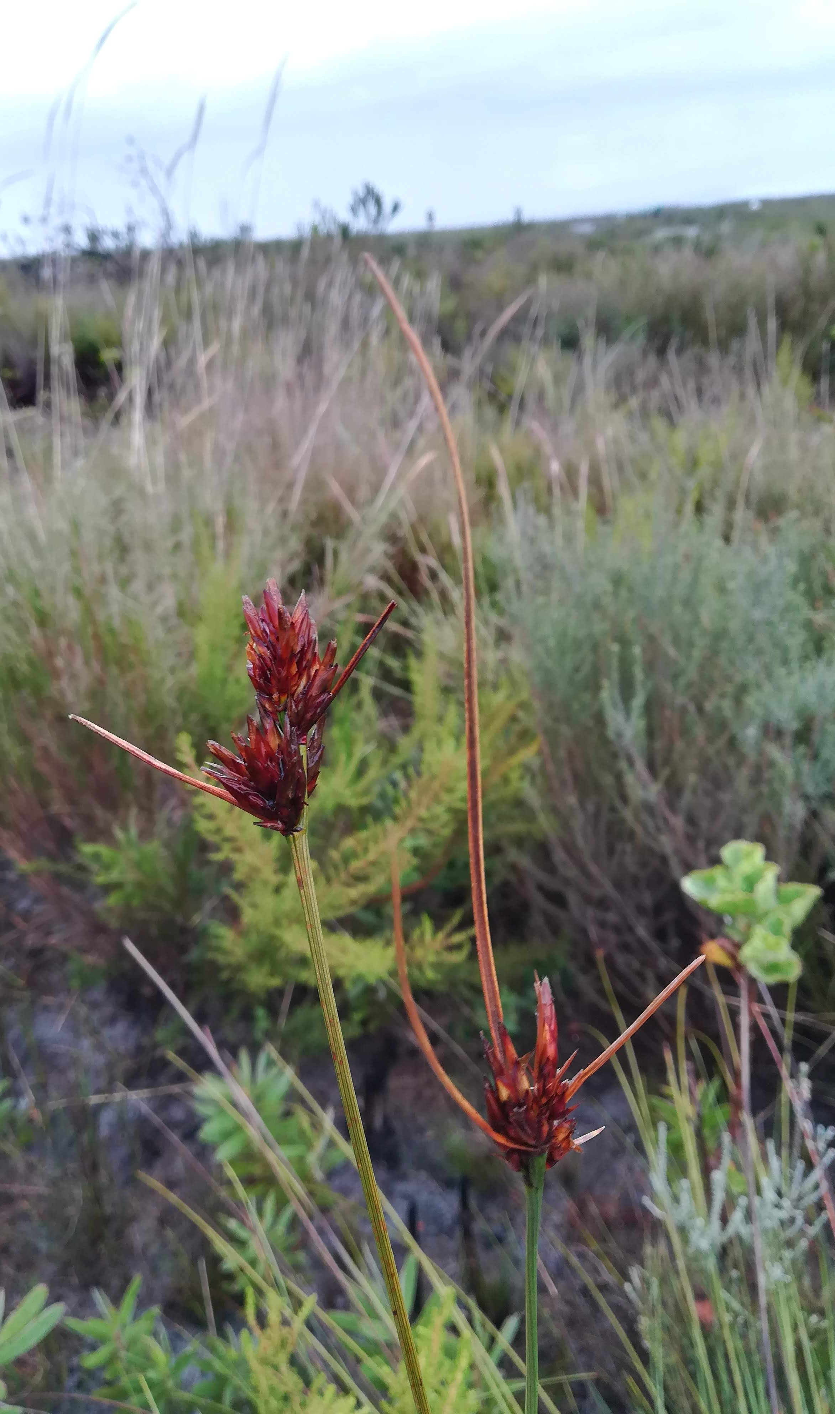
> introduce( )
Tetraria ustulata
Marloth NR
R. van Mazijk 2018
Tetraria thermalis
Silvermine, Table Mountain NP
R. van Mazijk 2018
Schoenus compar
Silvermine, Table Mountatin NP
R. van Mazijk 2018

Slide 7
> workshop$goals

Slide 8
> workshop$goals
More reproducible science

Slide 9
> workshop$goals
More reproducible science
Save time by:
Automating repetitive tasks
Eliminating human error

Slide 10
> workshop$goals
More reproducible science
Save time by:
Automating repetitive tasks
Eliminating human error
Boost your skills
Think about your data programmatically

Slide 11
Notes & slides will go up here:
tinyurl.com/r-with-ruan
(But I encourage you to make your own notes!)

Slide 12
> workshop$outline

Slide 13
> workshop$outline[1:3]

Slide 14
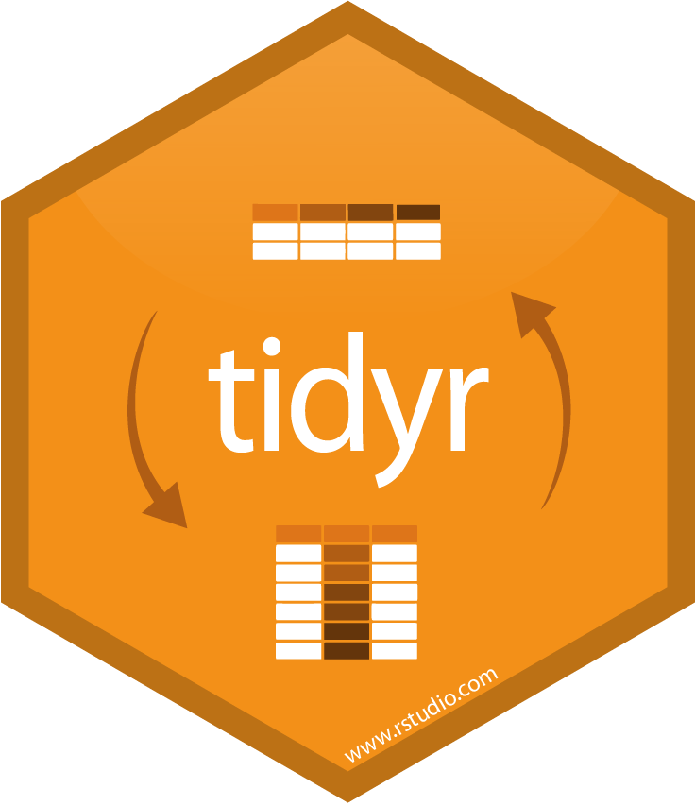
> workshop$outline[1:3]
DAY 1
Tidy data principles
& tidyr

Slide 15

> workshop$outline[1:3]
DAY 1
Tidy data principles
& tidyr
DAY 2
Manipulating data
& an intro to dplyr
DAY 3
Extending your data
with mutate(),
summarise()
& friends

Slide 16
> workshop$outline[-(1:3)]

Slide 17
> workshop$outline[-(1:3)]
2 dialects of R:

Slide 18
> workshop$outline[-(1:3)]
2 dialects of R:
base
$ [] [[]]
apply() which() subset()

Slide 19



> workshop$outline[-(1:3)]
2 dialects of R:
base
$ [] [[]]
apply() which() subset()
tidyverse

Slide 20
data <- read.csv("my-data.csv")

Slide 21
😅
data <- read.csv("my-data.csv")
data1 <- f(data, arg1 = "something")

Slide 22
😅 😥
data <- read.csv("my-data.csv")
data1 <- f(data, arg1 = "something")
data2 <- g(data1, another.thing = "blah")

Slide 23
😅 😥 😰
data <- read.csv("my-data.csv")
data1 <- f(data, arg1 = "something")
data2 <- g(data1, another.thing = "blah")
data3 <- h(data2, a.setting = TRUE)

Slide 24
😅 😥 😰 🤕
data <- read.csv("my-data.csv")
data1 <- f(data, arg1 = "something")
data2 <- g(data1, another.thing = "blah")
data3 <- h(data2, a.setting = TRUE)
data4 <- data3[data3$a.column == "cough", ]

Slide 25
😅 😥 😰 🤕
data <- read.csv("my-data.csv")
data1 <- f(data, arg1 = "something")
data2 <- g(data1, another.thing = "blah")
data3 <- h(data2, a.setting = TRUE)
data4 <- data3[data3$a.column == "cough", ]

Slide 26
data <- read.csv("my-data.csv")

Slide 27
data <- read.csv("my-data.csv")
data <-
data

Slide 28
data <- read.csv("my-data.csv")
data <-
f(data, arg1 = "something")

Slide 29
data <- read.csv("my-data.csv")
data <-
g(
f(data, arg1 = "something"),
another.thing = "blah"
)

Slide 30
data <- read.csv("my-data.csv")
data <-
h(
g(
f(data, arg1 = "something"),
another.thing = "blah"
),
a.setting = TRUE
)

Slide 31
😐
data <- read.csv("my-data.csv")
data <-
h(
g(
f(data, arg1 = "something"),
another.thing = "blah"
),
a.setting = TRUE
)

Slide 32
😐
data <- read.csv("my-data.csv")
data <-
h(
g(
f(data, arg1 = "something"),
another.thing = "blah"
),
a.setting = TRUE
)

Slide 33
😐
data <- read.csv("my-data.csv")
data <-
h(
g(
f(data, arg1 = "something"),
another.thing = "blah"
),
a.setting = TRUE
)

Slide 34
😐
data <- read.csv("my-data.csv")
data <-
h(
g(
f(data, arg1 = "something"),
another.thing = "blah"
),
a.setting = TRUE
)

Slide 35
😐
data <- read.csv("my-data.csv")
data <-
h(
g(
f(data, arg1 = "something"),
another.thing = "blah"
),
a.setting = TRUE
)
data <- data[data$a.column == "cough", ]
🤬

Slide 36
Solution: the pipe!
%>%

Slide 37
Solution: the pipe!
%>%
{ } [ ] [[ ]] <- = ( ) , " " ' '

Slide 38
Read: “then”
Solution: the pipe!
%>%
{ } [ ] [[ ]] <- = ( ) , " " ' '

Slide 39
😅 😥 😰 🤕
data <- read.csv("my-data.csv")
data1 <- f(data, arg1 = "something")
data2 <- g(data1, another.thing = "blah")
data3 <- h(data2, a.setting = TRUE)
data4 <- data3[data3$a.column == "cough", ]

Slide 40
data

Slide 41
data
↓
f()
↓
g()
↓
h()

Slide 42
data
↓
f()
↓
g()
↓
h()
↓
Some subsetting

Slide 43
data
↓
f()
↓
g()
↓
h()
↓
Some subsetting
↓
new data

Slide 44
f(x)

Slide 45
f(x) sort(1:10)

Slide 46
f(x) sort(1:10)
x %>% f()

Slide 47
f(x) sort(1:10)
x %>% f() 1:10 %>% sort()

Slide 48
f(x, y) t.test(data$x, data$y)

Slide 49
f(x, y) t.test(data$x, data$y)
x %>% f(y) data$x %>% t.test(data$y)

Slide 50
😅 😥 😰 🤕
data <- read.csv("my-data.csv")
data1 <- f(data, arg1 = "something")
data2 <- g(data1, another.thing = "blah")
data3 <- h(data2, a.setting = TRUE)
data4 <- data3[data3$a.column == "cough", ]

Slide 51
😐
data <- read.csv("my-data.csv")
data <-
h(
g(
f(data, arg1 = "something"),
another.thing = "blah"
),
a.setting = TRUE
)
data <- data[data$a.column == "cough", ]
🤬

Slide 52
h(g(f(x)))

Slide 53
h(g(f(x)))
x %>%

Slide 54
h(g(f(x)))
x %>%
f() %>%

Slide 55
h(g(f(x)))
x %>%
f() %>%
g() %>%

Slide 56
h(g(f(x)))
x %>%
f() %>%
g() %>%
h()
data
↓
f()
↓
g()
↓
h()
↓
Some subsetting
↓
new data

Slide 57
data <- read.csv("my-data.csv")
data <-
h(
g(
f(data, arg1 = "something"),
another.thing = "blah"
),
a.setting = TRUE
)

Slide 58
data <- read.csv("my-data.csv")
data <- data %>%
f(arg1 = "something") %>%
g(another.thing = "blah") %>%
h(a.setting = TRUE)

Slide 59
data <- read.csv("my-data.csv")
data <- data %>%
f(arg1 = "something") %>%
g(another.thing = "blah") %>%
h(a.setting = TRUE)
data
↓
f()
↓
g()
↓
h()
↓
Some subsetting
↓
new data

Slide 60
data <- read.csv("my-data.csv")
data <- data %>%
f(arg1 = "something") %>%
g(another.thing = "blah") %>%
h(a.setting = TRUE)
???????
🤭
data <- data[data$a.column == "cough", ]

Slide 61
> workshop$outline[1:3]
DAY 1
Tidy data principles
& tidyr
DAY 2
Manipulating data
& an intro to dplyr
DAY 3
Extending your data
with mutate(),
summarise()
& friends

Slide 62
> workshop$outline[[1]]
DAY 1
Tidy data principles
& tidyr

Slide 63
> workshop$outline[[1]]
DAY 1
Tidy data principles
& tidyr

Slide 64
A motivating example…

Slide 65
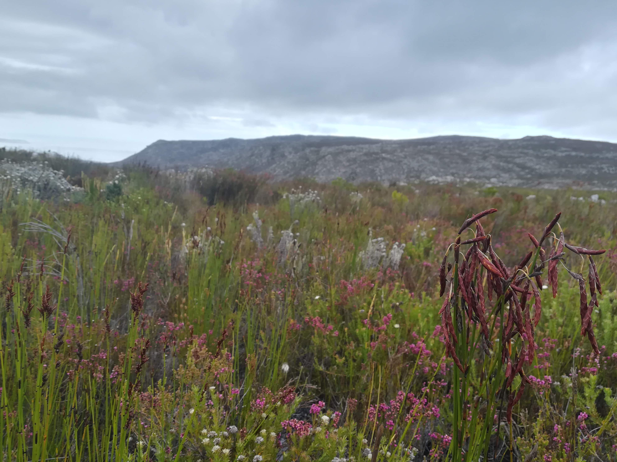
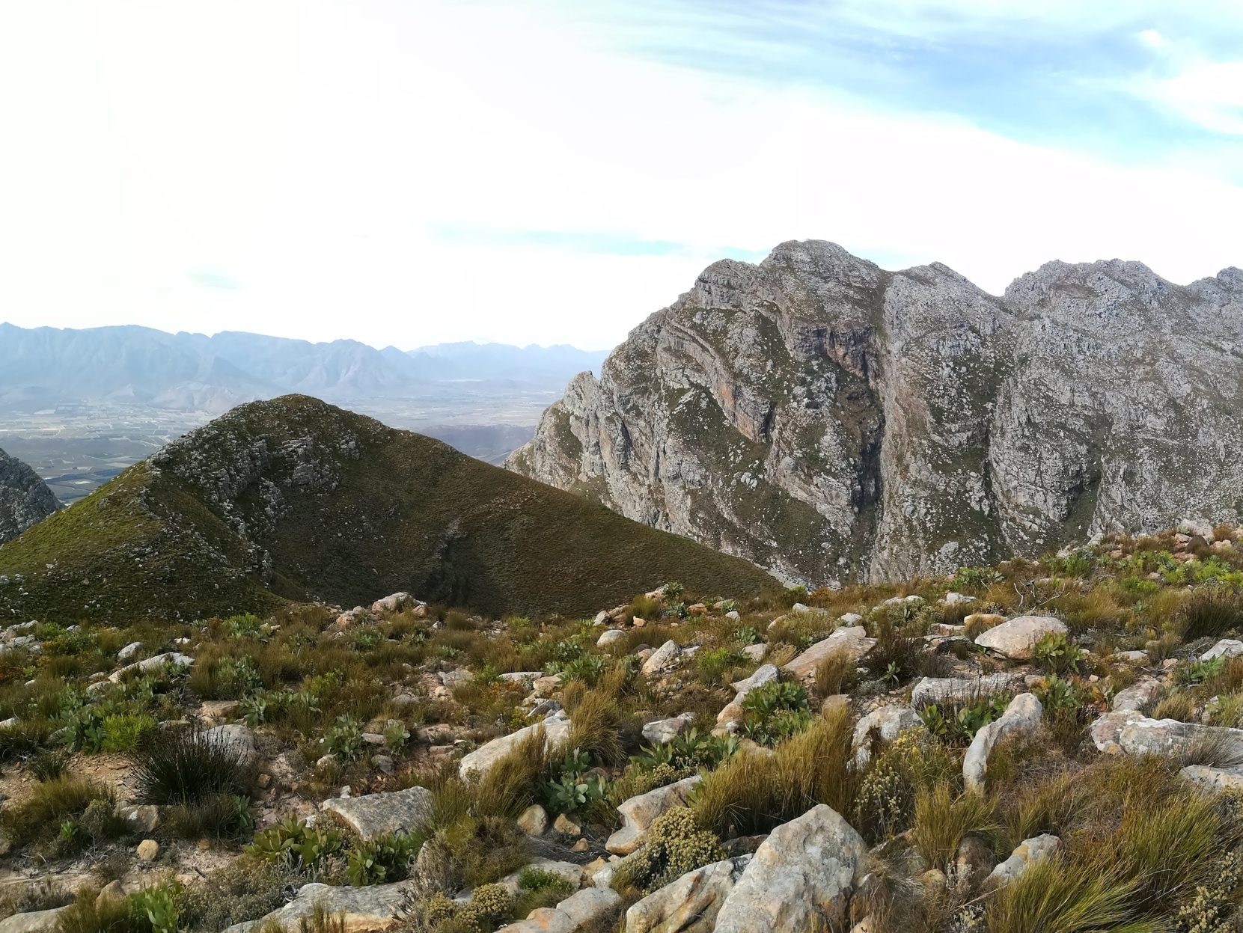
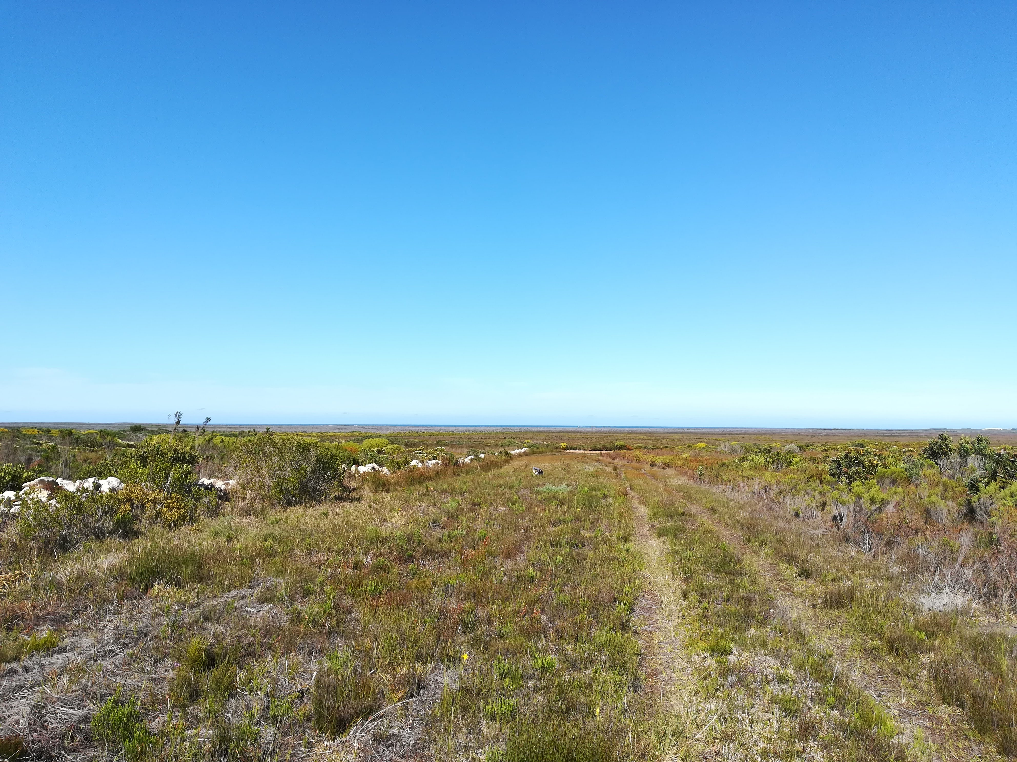
Kogelberg NR,
R. van Mazijk 2019
Observation Pk,
R. van Mazijk 2018
Near Pearly Beach, Agulhas Plains,
R. van Mazijk 2018
An example data-collection scenario in biology

Slide 66
Kogelberg NR,
R. van Mazijk 2019
Observation Pk,
R. van Mazijk 2018
Near Pearly Beach, Agulhas Plains,
R. van Mazijk 2018
An example data-collection scenario in biology

Slide 67

Kogelberg NR,
R. van Mazijk 2019
Observation Pk,
R. van Mazijk 2018
Near Pearly Beach, Agulhas Plains,
R. van Mazijk 2018
An example data-collection scenario in biology

Slide 68

Kogelberg NR,
R. van Mazijk 2019
Observation Pk,
R. van Mazijk 2018
Near Pearly Beach, Agulhas Plains,
R. van Mazijk 2018
An example data-collection scenario in biology

Slide 69

Kogelberg NR,
R. van Mazijk 2019
Observation Pk,
R. van Mazijk 2018
Near Pearly Beach, Agulhas Plains,
R. van Mazijk 2018
An example data-collection scenario in biology

Slide 70
(A good way to collect your data!)

Slide 72
Site 1 |  |  | Site 2 |  |  | Site 3
Sp 1 | Sp 2 | Sp 3 | Sp 1 | Sp 2 | Sp 3 | Sp 1 | Sp 2 | Sp 3

Slide 73
Site 1 |  |  | Site 2 |  |  | Site 3
Sp 1 | Sp 2 | Sp 3 | Sp 1 | Sp 2 | Sp 3 | Sp 1 | Sp 2 | Sp 3
One way to lay out your collected data… 🤢

Slide 74
Site 1 |  |  | Site 2 |  |  | Site 3
Sp 1 | Sp 2 | Sp 3 | Sp 1 | Sp 2 | Sp 3 | Sp 1 | Sp 2 | Sp 3

Slide 75
Site 1 |  |  | Site 2 |  |  | Site 3
Sp 1 | Sp 2 | Sp 3 | Sp 1 | Sp 2 | Sp 3 | Sp 1 | Sp 2 | Sp 3
???

Slide 76
Site 1 |  |  | Site 2 |  |  | Site 3
Sp 1 | Sp 2 | Sp 3 | Sp 1 | Sp 2 | Sp 3 | Sp 1 | Sp 2 | Sp 3
🤢
???

Slide 77
Site 1 |  |  | Site 2 |  |  | Site 3
Sp 1 | Sp 2 | Sp 3 | Sp 1 | Sp 2 | Sp 3 | Sp 1 | Sp 2 | Sp 3
🤢
???
😤

Slide 78
 | Site 1 |  | Site 2 |  | Site 3
Sp
Another way… 😬

Slide 79
Sp | Site
😍😘
👄😳
The “best” way.
(Will make your life easiest in the long-term.)

Slide 80
TIDY DATA
Sp | Site
😍😘
👄😳
The “best” way.
(Will make your life easiest in the long-term.)

Slide 81
TIDY DATA
CC BY-NC-ND 3.0 Grolemund & Wickham 2017. R for Data Science

Slide 82
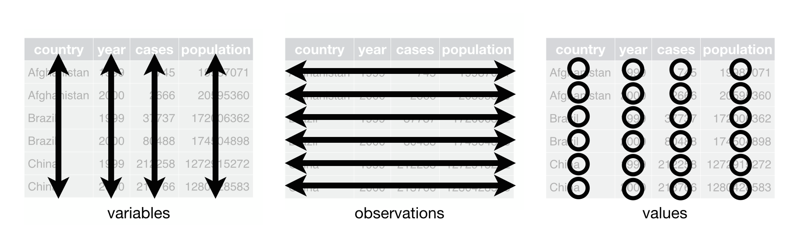
TIDY DATA
CC BY-NC-ND 3.0 Grolemund & Wickham 2017. R for Data Science

Slide 83
TIDY DATA
1. Each variable must have its own column
2. Each observation must have its own row
3. Each value, therefore, must have its own cell
CC BY-NC-ND 3.0 Grolemund & Wickham 2017. R for Data Science

Slide 84
tidyr
An R-package all about getting to this:
CC BY-NC-ND 3.0 Grolemund & Wickham 2017. R for Data Science

